Slide 1
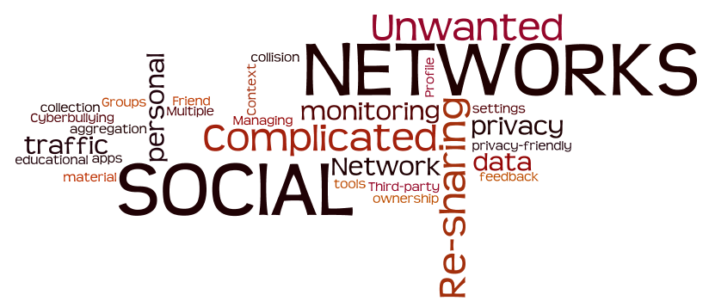
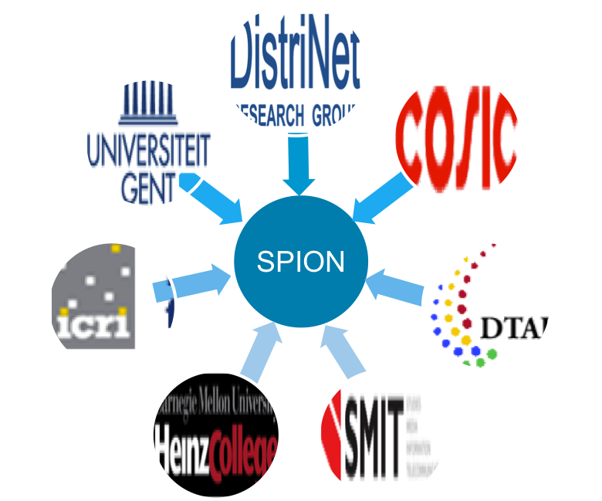
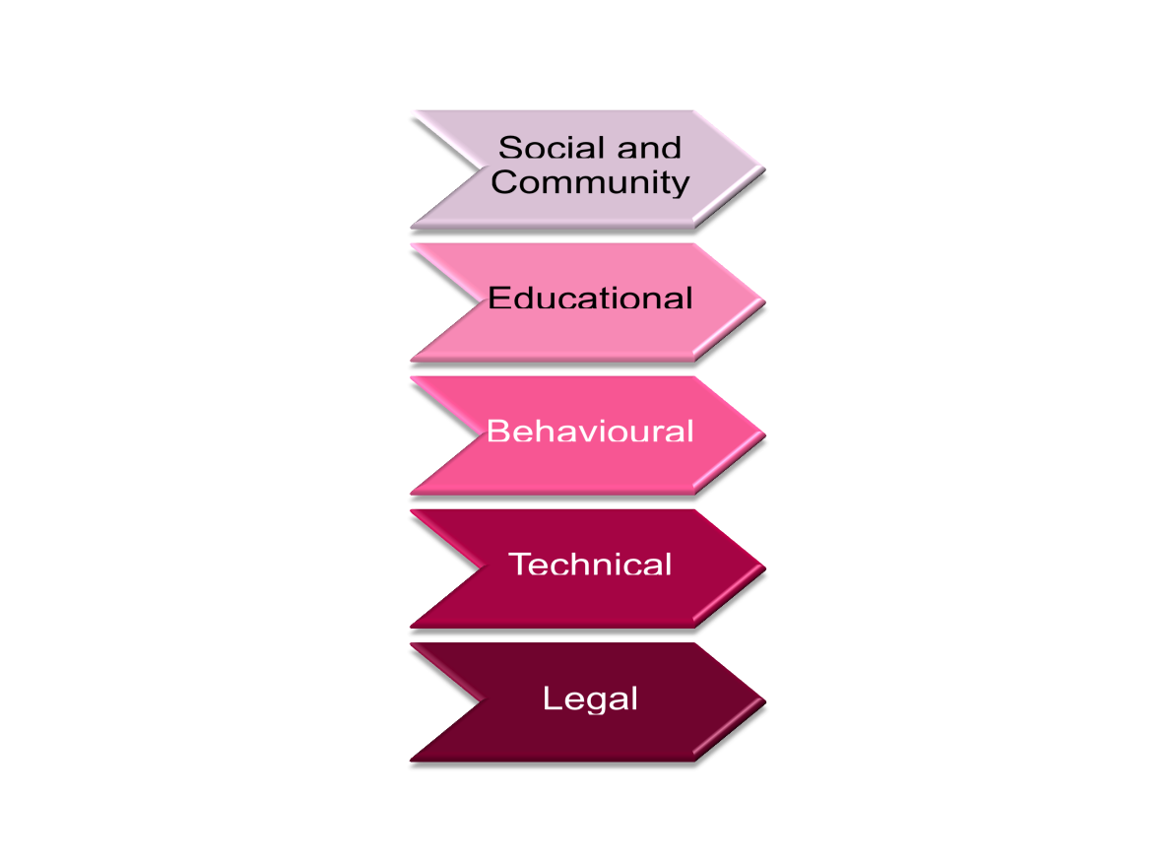
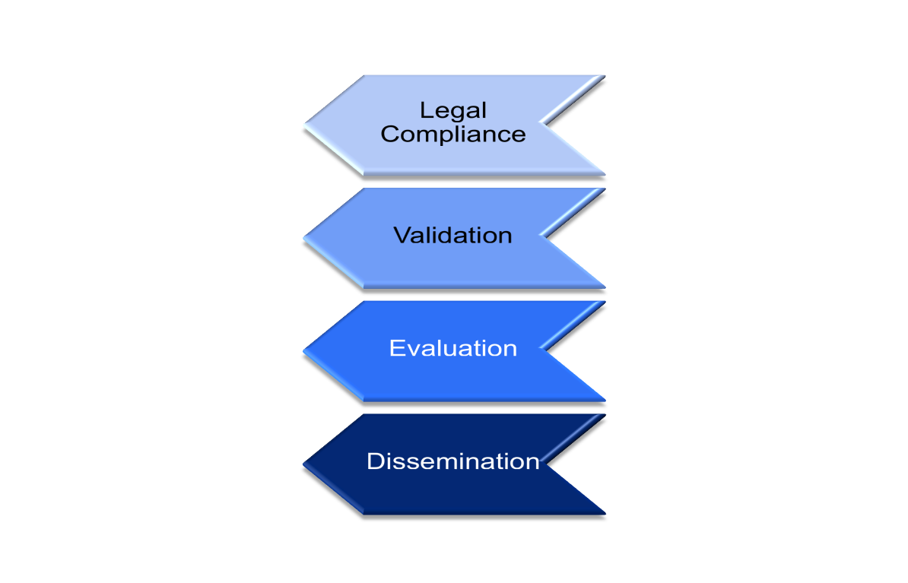

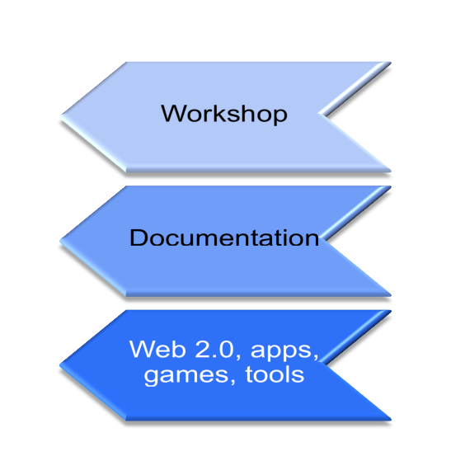
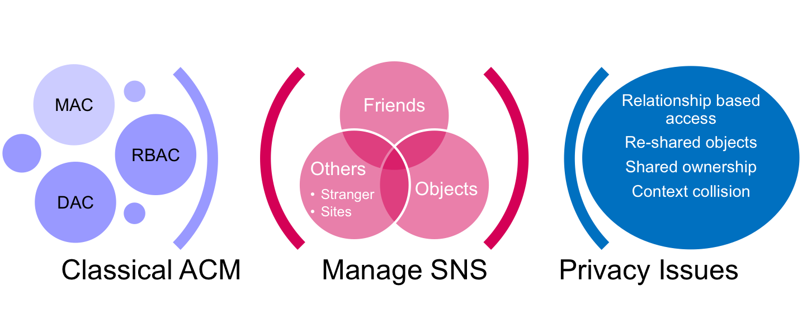
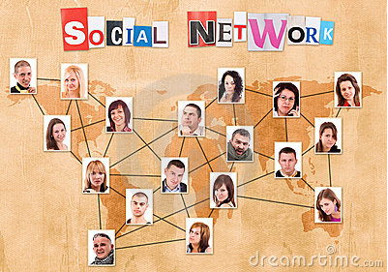



SPION
http://distrinet.cs.kuleuven.be/research/projects/SPION
Security and Privacy In online
social networks
D. Clarke
F. Piessens
important part of daily digital interactions
various types of issues compromise users’ privacy and security
Enhanced access control models
Enhance information
flow control
Evaluate developed solutions
Impact of offline
social networks
on online ones
01/01/2011
31/12/2014
Define actors, rights,
Obligations, account-ability and liability
Impact of offline
social networks
on online ones
Social Network Issues
Assist security and privacy decision
making
Impact of offline
social networks
on online ones
Multi-disciplinary approach to address social networks issues
Analyze and mitigate individuals responsibilization
Identify risks and privacy requirements
Propose privacy and security tools.
IBBT
Research Partners
DTAI
KU Leuven
Cosic
KU Leuven
ICRI
KU Leuven
SMIT
V.U.B
OWK
UGent
CMU
Carnegie Mellon University
SPION Valorization and Research Flow
Socio-technical solutions
Individuals
Legal transparency and accountability
Communication
Educational solutions
Organizations
Policy and decision makers
Study responsibility
Develop solutions
Evaluate solutions
Ongoing valorization
User group
Access Control Models
Technical Objectives
Access control models for social networks
Secure information flow methodologies
Audit and accountability approaches
Encryption-based solutions
Graph anonymization
Content Protection
Traffic Data Protection
SBO

